Slide 1
Design of Experiments (DoE)
Analyst Guide
TRAC-HQ-TM-08-020
September 2009
TRADOC Analysis Center
255 Sedgwick Avenue
Fort Leavenworth, KS 66027-2345
Distribution Statement: Approved for public release; distribution is unlimited.

Slide 2
DoE COBP
Purpose: To provide an overview of DoE practices and guidelines within analyses utilizing models and simulations (M&S).
This is not a DoE instructional manual; rather, it is an overview of options and general guidance; training, experience, and/or SME consultation will likely be required for application.
  Content:
  Overview of DoE
  Definitions
  Considerations and Guidelines
  Design Examples
  Implementation Examples
  Tools & References
30 September 2009
DoE Analyst Guide

Slide 3
Overview of DoE
Design of Experiments is a structured series of tests which systematically manipulate selected input variables in order to determine the effect(s) on the environment under study.
DoE requires the use of statistics often available in the form of software applications.
DoE is widely used to optimize manufacturing and production systems.
DoE may be effectively applied to examine a range of options utilizing M&S.
An efficient testing methodology may reduce the number of runs or experiments necessary to complete an analysis, and/or may enable the examination of a larger range of input variables and settings and/or establish stronger cause and effect relationships.
30 September 2009
DoE Analyst Guide

Slide 4
DoE Value
Design of Experiments enables the efficient application of scarce resources (time and effort) by allowing analysts to:
Take a systematic approach.
Identify and reduce the number of tests or runs needed.
Reduce variability.
Define, span and/or fill the experimental space.
Determine the most important factors.
Identify complex interactions.
Optimize system response.
Develop a mathematical model of a system.
Use standardized methods to analyze the results.
Conduct appropriate analysis.
DoE is a rigorous application of the scientific method and avoids “best guess” or “one-variable-at-a-time testing.”
30 September 2009
DoE Analyst Guide

Slide 5
Content:
Overview of DoE
Definitions
Considerations and Guidelines
Design Examples
Implementation Examples
Tools & References
30 September 2009
DoE Analyst Guide

Slide 6
Definitions
(1 of 2)
Design – plan by which experiment will be conducted and data obtained.
System – the environment being studied.
Input Variable – (input, independent) the items of interest that can be manipulated for the purpose of the experiment.
Response Variable – (output, dependent) the item(s) that are observed or measured from the system.
Levels – the settings that a Input Variable will take on for the purposes of the experiment.
Experimental Unit – the smallest unit to which a Treatment is applied.
Treatment – the set of Input Variable levels that are applied to an Experimental Unit.
Variance – the deviation of measurements from their mean.
Block – account for non homogeneous Experimental Units thereby reducing variability in the system.
Alias – effects that cannot be separated from one another, allowing a Design with fewer Treatments.
Interaction – when the response of two or more Input Variables is not a simple sum of each of their individual effects.
Degrees of Freedom (DOF) – number of parameters that can be independently varied. One DOF is required for each parameter estimate. For each Input Variable, this is number of levels minus 1. For interaction terms this is product of the number of levels minus 1 for each Input Variable involved in the interaction.
30 September 2009
DoE Analyst Guide

Slide 7
Definitions
(2 of 2)
Resolution – degree to which effects are Aliased. Res V: main effects not aliased with 3-way or lower interaction, 2-way interactions not aliased with other 2-way interactions. Res IV: main effects not aliased with 2-way interactions. Res III: main effects not aliased with other main effects (screening experiments).
Screening Experiment – an experiment to determine the most important Input Variables in a system, usually to limit the number of Input Variables for further study.
Response Surface – (contour plot) a n-dimensional surface created by plotting the n Input-Variable levels against a Response Variable. For two Input Variables, this would look like a 3-D terrain map. They are categorized here as: linear (flat, planar, hyper-planer, including log, inverse, and squared transformations to linear); quadratic (curved in at least 1 dimension – can be approximated by a quadratic function); and complex (non-linear with multiple peaks and/or sharp ridges/valleys).
Orthogonal – treatment designs such that the Treatments are linearly independent. This is desirable to facilitate analysis and reduce variability in parameter estimates.
Experimental Space – the area of experimentation defined by the upper and lower levels for each of the Input Variables in n dimensions.
Space Filling – the ability of a design to space observation points evenly throughout the design space. This is critical when the Response Surface is complex.
30 September 2009
DoE Analyst Guide

Slide 8
Content:
Overview of DoE
Definitions
Considerations and Guidelines
Design Examples
Implementation Examples
Tools & References
30 September 2009
DoE Analyst Guide

Slide 9
Design Considerations
Analysts should address the following questions when selecting an appropriate design.
Is there a limit to the number of trials or runs available to support the study?
  Resource constraints could dictate design type or could limit the scope of the study.
How many input variables will be studied?
  A screening experiment may be necessary to determine the most critical variables.
What types of variables are the factors?
  Qualitative or discrete variables will limit design choices.
How much interaction between the factors is expected?
  Testing and accounting for interaction requires additional runs.
What shape response surface is expected (linear, quadratic, complex)?
  Designs accommodating non-linear responses require additional runs.
30 September 2009
DoE Analyst Guide

Slide 10
DoE Guidelines
Consider experimental design early in the study to determine possible limitations or potential for follow on work.
Balance thoroughness and efficiency using the design. Don’t design an experiment that produces more data than is necessary to answer the study questions. Generally, use the simplest or least resource intensive method that meets the study’s needs.
Calculate how many treatments and runs may be required when selecting a design.
Decide the level of interaction and non-linearity to account for when selecting a design. Don’t ignore 2-way interactions without justification. 3-way interactions should also be included if possible. Combat simulations often produce non-linear or complex response surfaces.
Select both factors and response variables carefully. Consider using SME input and/or a screening experiment to reduce the number of variables, but recognize this will require additional runs.
30 September 2009
DoE Analyst Guide

Slide 11
Content:
Overview of DoE
Definitions
Considerations and Guidelines
Design Examples
Implementation Examples
Tools & References
30 September 2009
DoE Analyst Guide

Slide 12
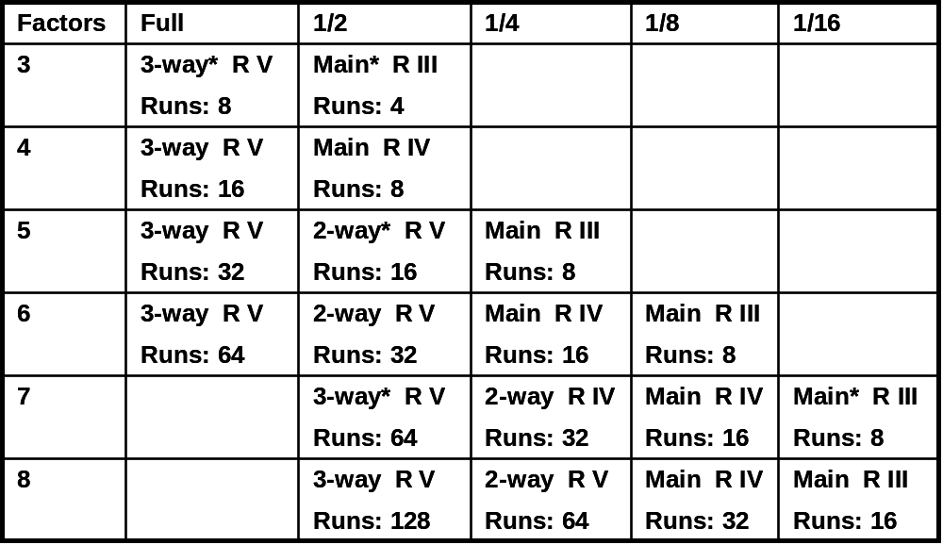
Factorial and Fractional Factorial
Description: A factorial design is used to consider each factor at both a high level and a low level including all interactions; this requires 2^{n} treatments. A fractional factorial, simply a fraction (¹/_{k}) of the full factorial design, may suffice; the fractional design requires 2^{n-k} treatments.
Features: Simple, easily understood design with few treatments required.
Limitations: Does not sample from the interior of the experimental space and only produces linear models.
Uses: Screening experiments, identifying interactions, or when time/resources are constrained.
Resources: Plackett-Burman tables are available for structuring larger designs. Factorial designs are also supported by most statistical software packages.
Analysis: Can use ANOVA, regression, Yate’s method, and/or half normal plots to analyze output.
Depiction of Factorial sampling in 2 dimensions
Examples of Fractional Factorial Designs
Given # factors, table displays the highest order of non-aliased interaction (Main to 3-way), resolution (R, from I to V), and # treatments (#Runs = 4 to 64).
High
Low
Low
High
# treatments = 2^{n-k}
n = # factors
k = fraction (1/2^{k})
* Design uses all available DOF requiring estimate of error through half normal plot.
30 September 2009
DoE Analyst Guide

Slide 13

Central Composite (Box-Wilson)
Description: A central composite design is used to add additional treatments to the basic factorial design in order to estimate non-linear parameters. This is more efficient than 3^{n} designs.
Features: Creates a quadratic model response surface (or contour plot). May conduct experiment in stages by omitting treatments from axial portion if no evidence of non-linearity is found.
Limitations: Uses only one design point in the center of the experimental space, creates a quadratic model.
Uses: For non-linear cases when a quadratic model is an acceptable approximation.
Resources: Supported by most statistical software packages.
Analysis: Can use regression, ANOVA, and various software packages to analyze output.
Depiction of a Central Composite Design in 2 dimensions
Central Composite Design
Begin with full factorial design (choosing levels not at the limits of factor range).
Run center points.
Evaluate for non-linearity.
Design and run axial portion if necessary.
Axial Portion Design
Set one factor at +/- “α”, rest at center point.
α = (for rotatable design)
Rotatability is desirable, but not required.
# treatments = 2^{n} + 2n + c
n = # factors
2^{n} = factorial portion
2n = axial portion
c = center point, 1 minimum, 3 or more recommended
Other Designs
May be adapted for fractional factorials.
Box-Behnken is not as powerful, but requires fewer treatments.
30 September 2009
DoE Analyst Guide

Slide 14
D-Optimal
Description: A D-Optimal design is used when factorial or fractional factorial designs are too large to run and when complex non-linear interactions between factors are expected. D-Optimal designs are constructed by computer algorithms to maximize the determinant of the information matrix of candidate treatment sets.
Features: D-Optimal designs can accommodate both qualitative/discrete variables and quantitative/continuous variables. Specific treatments can be specified to be included in or excluded from the design. The user specifies the number of treatments to be used.
Limitations: No table of ready-made designs is available. D-Optimal designs are not supported by all statistical software packages. The designs generated are rarely orthogonal.
Uses: D-Optimal designs may be used anytime, but are typically used when there are a large number of relevant factors or when some of factor levels are infeasible or impossible to test. D-Optimal designs can handle complex non-linear interactions.
Resources: JMP statistical software.
Analysis: Non-linear regression is recommended since any level of non-linear interactions may arise from a D-Optimal design.
Depiction of a D-Optimal design with 12 treatments from 5X2X2 factorial
We recommend developing several D-Optimal designs and choosing the best because the random seed can affect the final design.
30 September 2009
DoE Analyst Guide

Slide 15
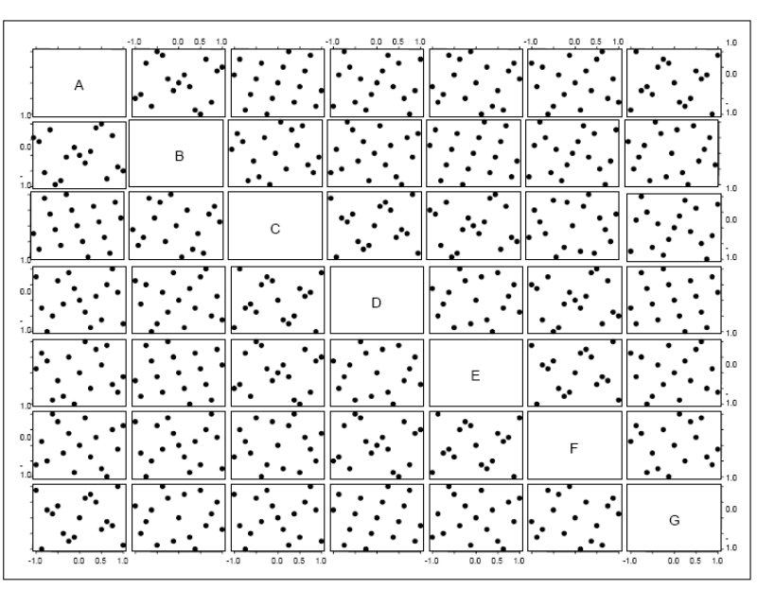
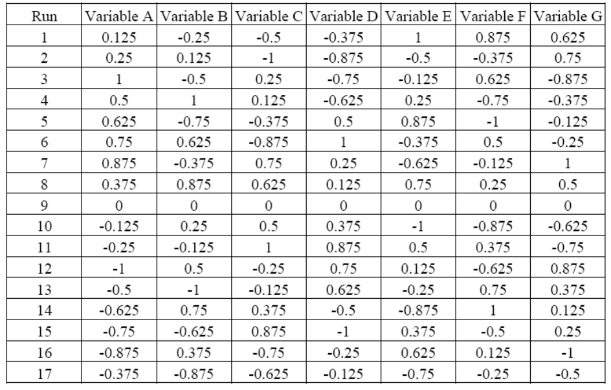
Nearly Orthogonal Latin Hypercubes
Description: A Latin hypercube design is used to maintain near orthogonality among factors while providing efficient space filling.
Features: Allows for a high degree of nonlinearity. Requires less treatments than traditional designs.
Limitations: Designs may be large and complex. Factors must be quantitative and near continuous. Software applications are not commercially available.
Uses: For highly non-linear, complex responses.
Resources: Tables of designs for up to 22 variables are available (Reference at end of brief). Application tools in development at Monterey. Related designs are in development at NPS SEED Center.
Analysis: Regression, ANOVA.
Number of treatments required
# factors | # treatments
Up to 7 | 17
8-11 | 33
12-16 | 65
17-22 | 129
Design generation procedure may be extended for larger experiments
2 dimensional projections of a 7 variable design
Recommended 7 variable design in 17 treatments
30 September 2009
DoE Analyst Guide

Slide 16
Recommended Designs
Some useful designs are suggested here. This is not intended to limit the choices available to the analyst.
Design | Features | Limitations | Use When
Fractional Factorial | Ease of use Min # treatments Can adjust for expected level of interaction | Linear model Possible aliased effects 2 levels for each factor Samples only from edges of experimental space | Screening factors Nonlinearity is not a concern
Central Composite | Quadratic model (smooth non-linear) Ease of use Can truncate if linear response found | Continuous quantitative variables Poor space filling | Nonlinearity is a concern, but a quadratic response surface is expected
D-Optimal | Adjustable for: Type of variables Interactions Levels per factor | Software required for design and analysis May not be orthogonal | Mixed types of variables Including or excluding specific treatment combinations
Nearly Orthogonal Latin Hypercube | Maintains near orthorgonality Excellent space filling Fewer treatments than other designs in this class | Continuous quantitative variables required Complex designs More treatments than other designs presented here | Complex non-linear response surface is expected A large number of variables will be considered (7 to 22+)
30 September 2009
DoE Analyst Guide

Slide 17
Content:
Overview of DoE
Definitions
Considerations and Guidelines
Design Examples
Implementation Examples
Tools & References
30 September 2009
DoE Analyst Guide

Slide 18
Design Selection Example
Fractional Factorial Design Selection
(1 of 2)
This is a simple, fictional example to illustrate the design selection process.
5. Select levels:
Decision makers are considering BCT and DIV for levels of organization.
Feasibility limits # of BNs to 2 or 3 per BCT.
Scenarios available are A and B.
1. Background: TRAC is conducting a study to compare alternatives for organization of the modular force. A combat simulation will be used to support the study. The study parameters are not yet well defined; there are over 20 potential factors to explore.
2. Constraint: There is only time available for up to 12 simulation treatments. Two different scenarios will be used to limit bias.
3. Select factors: Because of the number of potential factors, a SME panel was assembled to identify the most critical factors for modular organization. The panel selected the following factors for investigation:
Basic unit of organization.
Level to organize aviation assets.
Number of CAB in a HBCT.
Number of STRYKER BN in a SBCT.
4. Identify variable types:
Unit of Org – qualitative.
Aviation Org – qualitative.
# CAB – quantitative, discrete.
# STRYKER – quantitative, discrete.
In addition scenario, considered a block, is
qualitative.
Factor | Low (-) | High (+)
Unit of Org | BCT | DIV
Aviation Org | BCT | DIV
# CAB | 2 | 3
# STRYKER | 2 | 3
Scenario | A | B
6. Consider designs:
Because time and resources are limited, concentrate on main effects only.
Central composite and Latin hypercube designs are inappropriate for qualitative and discrete variables.
The variables and levels specified cannot produce a non-linear response.
Fractional factorial is the simplest design that meets the study requirements, needing 8 treatments.
30 September 2009
DoE Analyst Guide

Slide 19
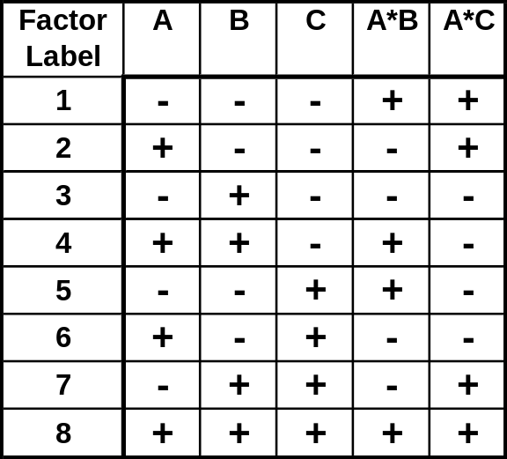
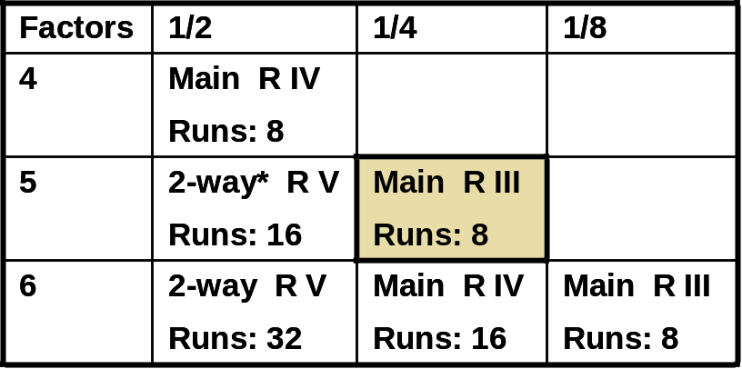
Design Selection Example
Fractional Factorial Design Implementation
(2 of 2)
Selected design:
Fractional Factorial.
Requires resolution III for main effects.
Use ¼ replication.
2⁵⁻² = 2³ = 8 treatments.
Treatment structure:
Assign levels for each factor, alternating - / + by 1s, 2s, 4s, etc.
Interaction factors such as A*B are found arithmetically.
Code Factors:
Randomize order of runs for field experiments or HITL simulation (not critical for closed form simulations).
Factor | Label | Low (-) | High (+)
Unit of Org | A | BCT | DIV
Aviation Assets | B | BCT | DIV
# CAB | C | 2 | 3
# STRYKER BN | A*B | 2 | 3
Scenario | A*C | SWA | NEA
Collect data: conduct simulations.
Analyze results:
Use ANOVA to determine significant effects.
Regression not recommended – factors are discrete or qualitative. A linear model would not have meaning.
30 September 2009
DoE Analyst Guide

Slide 20
Precision Munitions Mix Analysis (PMMA) DoE
Study to determine the best mix of precision munitions to support the current and future force.
Collect and analyze data:
Simulated in CASTFOREM.
Linear regression to create a mathematical model.
Select factors and responses:
Considered 35 munitions and 187 mission profiles.
Assigned and ranked up to 5 munitions to each mission.
Applied goal programming to identify versatile Army and Joint munitions.
Selected 12 munitions for further analysis.
Each munition type was a factor with 2 levels: included / excluded.
3 different scenarios were used.
Selected 11 response variables based on professional judgment and SME input.
Validate Model:
Selected 15 new treatments.
Predicted response variables using mathematical model.
Simulated same 15 treatments in CASTFOREM.
Compared outcomes.
Models deemed reasonable estimate of system response.
Application:
Model used in goal programming.
Considered all 2¹² munitions combinations.
Conducted sensitivity analysis of goal weighting values.
Design experiment:
Number of simulation treatments available was limited.
Study approach required consideration of main effects and generation of a linear model.
Factorial design: 2¹² ∙ 3¹ = 12,288 treatments.
Fractional factorial chosen: 2¹²⁻⁹ ∙ 3¹ = 24 treatments simulated.
Analysts utilized DoE to consider >12,000 possible munitions combinations using only 39 treatment cases within the combat simulation.
30 September 2009
DoE Analyst Guide

Slide 21
Army UAS Mix Analysis (AUMA) DoE
(1 of 2)
Study to determine if UAS requirements can be met with less than four platforms, if current or enhanced systems could meet future requirements, and develop an investment and transition strategy.
Select factors and responses:
Considered UAS type and Level of Control.
4 UAS Types used, with 2 levels: included / excluded.
5 Levels of Control were used, varying level by UAS Type and unit type (BDE).
Number of UAS required, by type, to meet mission requirements was the response.
Design experiment (continued):
Level of Control:
243 per Bde → thousands of combinations.
Developed assignment rules and screened for feasibility yielding 32 combinations to consider.
Systematically varied levels across the 5 treatments to determine importance.
Partial factorial design.
Design experiment:
Study was time constrained, limiting number of simulated treatments.
UAS Type:
2⁴ = 16 possible treatments.
Single and double UAS combinations discarded as tactically infeasible.
Remaining 5 design points selected (3 & 4 system combinations).
Full factorial with treatments excluded.
Collect and analyze data:
Simulated 5 treatments in ASC-U.
Level of control was statistically insignificant, and was discarded as a factor.
Steering committee discarded worst 2 cases.
Base case (all 4 types) and best 2 (3 type) alternatives were kept for further analysis.
30 September 2009
DoE Analyst Guide

Slide 22
Army UAS Mix Analysis (AUMA) DoE
(2 of 2)
Redesign experiment:
Included 2 additional UAS types
1 small that could be used instead of the 2 previous small types considered.
1 medium that could be used instead of the previous medium type considered.
Included treatments with only 2 UAS types.
3 platform mixes:
1 large of 1, 1 medium of 2, and 1 small of 3 included in each case to enhance mission accomplishment.
Full factorial: 1¹ ∙ 2¹ ∙ 3¹ = 6 treatments.
2 treatments from previous design.
4 treatments remaining.
2 platform mixes:
1 medium/large of 3 and 1 small of 3 included in each case to enhance mission accomplishment.
Full factorial: 3² = 9 possible treatment combinations.
Partial factorial design: 5 treatments selected (due to time constraints).
Allowed determination of main effects.
Accounted for the most important combinations to be simulated.
Collect and analyze data:
Simulated 9 additional treatments in ASC-U.
1 failed to meet threshold requirements and was discarded.
11 simulated combinations were further considered (Base + 2 + 8).
Upon analysis, 5 of those were inferior, and discarded by the steering committee.
Application:
A cost/investment analysis tool was developed in GAMS using the experimentation results.
The remaining 6 treatments were analyzed to determine the cost and time to field each UAS mix to the force.
DoE allowed:
Determination of critical factors.
Flexibility to add new factors and modify experiment.
Organization and systematic handling of a complex problem.
30 September 2009
DoE Analyst Guide

Slide 23
Content:
Overview of DoE
Definitions
Considerations and Guidelines
Design Examples
Implementation Examples
Tools & References
30 September 2009
DoE Analyst Guide

Slide 24
DoE Resources
Expertise:
Analysts trained in DoE through coursework as well as study experience reside at each TRAC location. Seek their counsel if unfamiliar with DoE techniques.
TRAC Monterey is a source of DoE innovation and has access to NPS faculty and the SEED (Simulation Experiments & Efficient Designs) Center. TRAC Monterey has consulted on various study DoE, including PMMA.
Software applications:
Spreadsheets are useful for simple analysis and displaying results. They do not offer automated tools for the design of experiments.
Many statistical software packages, such as Statistical Analysis Software (SAS) and JMP®, offer both automated design tools and statistical analysis tools. Products have varying levels of utility and typically there is not an agency-wide site license. Consult previous users and agency software control/information technology (IT) to select a software package.
Specialized tools may be developed in house or through collaboration with TRAC Monterey. TRAC Monterey has developed tools to support Latin hypercube designs and automate design and simulation processes. Consult with TRAC Monterey for availability and update on the latest projects and applications.
30 September 2009
DoE Analyst Guide

Slide 25
Summary
DoE facilitates analysis of complex problems, especially when available resources constrain a study effort. Numerous methods are available to address any design problem.
When preparing a study that may use multiple simulation runs:
Identify the study limitations as well as the factors and responses to investigate.
Develop the experiment design in conjunction with the study methodology.
Collect and analyze data systematically.
Develop insights or results to support the study.
“Design and analysis are complementary activities. The design must support the desired analysis, and the analysis should derive as much information as possible from the allotted runs. The two should not be considered mutually exclusive constructs, but must be considered from the onset in tandem.” – COL Thomas Cioppa, TRAC
30 September 2009
DoE Analyst Guide

Slide 26
References
Analysis of Messy Data Vol. 2, Nonreplicated Experiments, Millikin and Dallas, 1989.
Efficient Nearly Orthogonal and Space-Filling Experimental Designs for High-Dimensional Complex Models, Cioppa, 2002.
Empirical Model-Building and Response Surfaces, Box and Draper, 1987.
JMP Start Statistics, A Guide to Statistics and Data Analysis Using JMP and JMP IN Software, Sall and Lehman, 1996.
Simulation Modeling & Analysis, 4th Edition, Law, 2007.
Straight Talk on Designing Experiments, Launsby and Weese, 1995.
A User’s Guide to the Brave New World of Designing Simulation Experiments, Sanchez, Lucas, and Cioppa, 2005.
Working Smarter, Not Harder: Guidelines for Designing Simulation Experiments, Sanchez, 2006.
30 September 2009
DoE Analyst Guide

